Slide 1









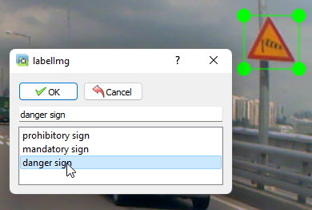
4. Data labeling
Software for labeling: LabelIMG
Supports YOLO
Coded in Python
Yolo is a supervised learning algorithm -> the data must be labeled
3 Different Classes of street Signs: prohibitory, mandatory and danger
Data is being labeled by manually drawing boundary boxes around the street signs and assigning the class
Box coordinates and class is saved into a .txt file
Two datasets:
First Dataset was provided by Digital Systems Lab of Hanyang University: 500 pictures
Second Dataset taken from driving video on YouTube: 500 pictures
prohibitory
mandatory
danger
labeling
Notes:
l

